Slide 1
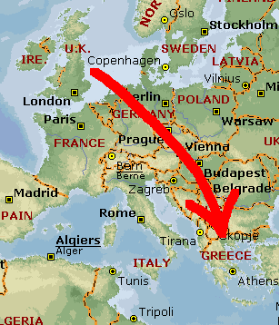
Where is Greece?
Sunny Greece is about a nine hour flight from Detroit.
It’s capital city is Athens
It is famous for its beautiful beaches and sea!

Slide 2
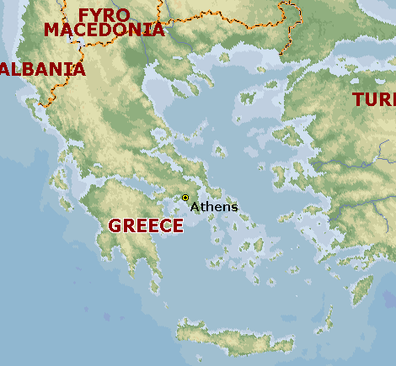
Ancient Greece
In Ancient Greece, the different cities were at war with each other.
The most fearsome fighters came from the town of Sparta.

Slide 3
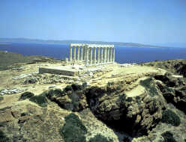
The Climate
The climate is Mediterranean.
The Mediterranean Sea affects the Greek climate, cooling the air in summer and providing warmth in winter.
The warm summers are cooled by a seasonal breezes from the Mediterranean called the ‘Meltemia’.

Slide 4
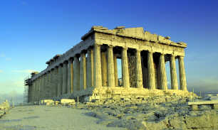
The Climate - Summer
The Greek summer is hot and dry.
On average the sun shines for 3,000 hours per year.
The average temperature is 91.4° F.
In Detroit it is 86°.
The average rainfall is .236 inches.
In Detroit it is 3.27 inches.

Slide 5
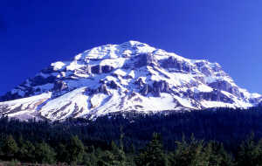
The Climate - winter
The Greek winter is moderate. It can be rainy on costal regions and snowy in the mountains.
The average temperature is 59° F.
In Detroit it is 33.8° F, sometimes falling to17.8°.
The average rainfall is 2.6 inches.
In Detroit it is 2.1 inches.

Slide 6
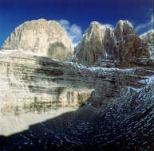
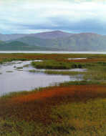
Ancient greece - terrain
Greece has a very scenic landscape.
The terrain of Greece is very varied.
There are mountains, valleys and coasts.
The high mountains are separated by deep valleys through which rivers flow.

Slide 7
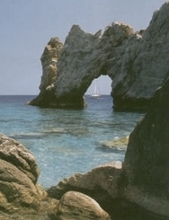
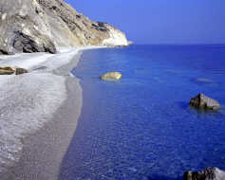
Ancient greece - terrain
No part of Greece is more than about forty miles from the coast (a couple of days walking).
There are lots of islands surrounding Greece.
However, millions of years ago the seabed was completely dry!

Slide 8
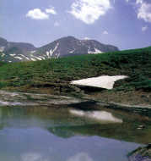
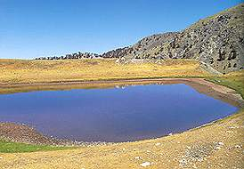
soil and plants
Vegetation is dependent on geographical regions.
Due to the variety of land, there a some 6,000 indigenous species in Greece.
In Ancient Greece, farmers grew olives, figs, grain, fruit and grapes in the fertile valleys.

Slide 9
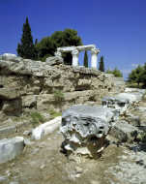
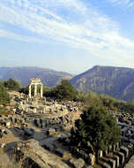
Soil and plants
However, other parts of Ancient Greece had drier soil and less vegetation, particularly around the cities.
Although surrounded by sea water, they found it difficult to find fresh water away from the valleys.
The high mountains also prevented large-scale farming, so the Greeks were forced to look beyond their own country for fertile land.

Slide 10
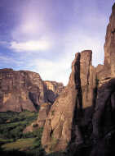
volcanic
Another important aspect of the Greek environment is that it is very unstable.
Greece is in the middle of a very volcanic zone, between the European and African tectonic plates.
There are several active volcanoes and earthquakes are common.

Slide 11
Time Line
776 BC | The first Olympic games.
about 750 BC | Early Greek culture. Homer '. writes the epics 'The Iliad' and the 'Odyssey
650 - 580 BC | Corinth is ruled by the tyrant Kypselos and then his son Periander.
508 BC | Democracy begins in Athens
490 and 480 BC | Greeks defeat Persian invaders at the battles of Marathon (490 BC)and Salamis (480 BC).
by 450 BC | Athens becomes a very powerful city, and controls an empire.
472 - 410 BC | Greeks theatre thrives in Athens. Many of the most famous Greek plays are written during this time.

Slide 12
Time line
462 - 429 BC | Perikles is the popular leader at Athens as the general of the Athenian army
432 BC | The Parthenon in Athens is finished being built.
431 - 404 BC | War between Athens and Sparta (the Peloponnesian war)
428 BC | The revolt of Mytilene
404 BC | Sparta defeats Athens.
338 BC | Philip, king of Macedonia, takes control of Greece
336 - 323 BC | Alexander the Great, son of Philip, conquers most of the known world as far east as India.
146 BC | Rome conquers Greece - Greece becomes part of the Roman empire.

