Slide 1
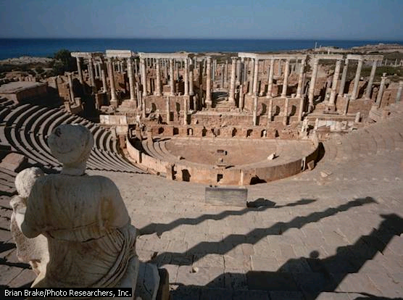
Chapter 5
Ancient Rome and The Rise of Christianity

Slide 2
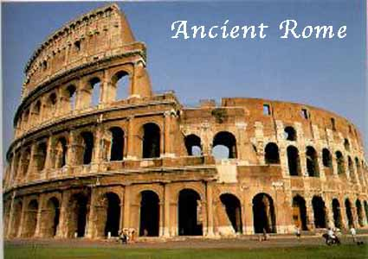
The Roman World Takes Shape

Slide 3
Roman civilization Arises in Italy
Italy is a peninsula that is centrally located in the Mediterranean sea.
Italy was much easier to unify than Greece.
The mountains were less rugged.
The fertile plains of the north and west supported a growing population.
Latins migrate into Italy around 800 B.C.

Slide 4
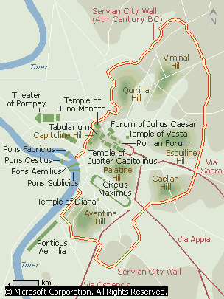
Roman civilization Arises in Italy
The Latins settled near the
Tiber River
They lived in small villages
scattered over 7 small hills.
They were herders and
farmers.
The villages would grow
together and become
Rome.

Slide 5
Roman civilization Arises in Italy
The Legend of Rome
Romulus and Remus, twin sons of the god Mars
  Left by their mother’s husband along the banks of the Tiber River
  Raised by a she-wolf
  Romulus built a city wall, Remus mocked him saying it was too small
  Romulus killed him in anger – named the city Rome after himself

Slide 6
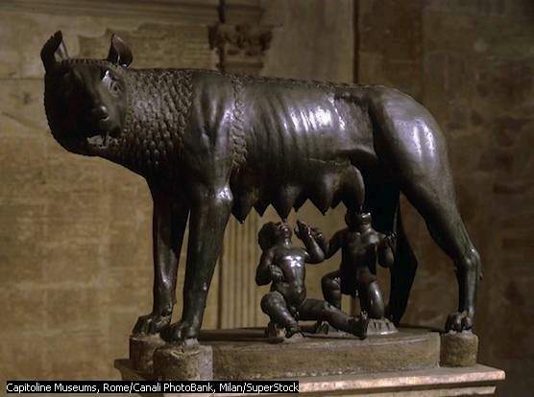

Slide 7
Romans
Settled in the Tiber River Valley
Settled in the Southern portion of Italy and in Sicily
Settled in Northern and Central Italy

Slide 8
Roman civilization Arises in Italy
The Etruscans were a group of people who came from Asia Minor or the Alps. We don’t know yet?
They settled in Northern Italy.
The Etruscans greatly influenced the city of Rome. They built temples, shops, roads, and homes and influenced other aspects of Roman culture as well.
The Romans adapted their alphabet and the use of the arch in construction.

Slide 9
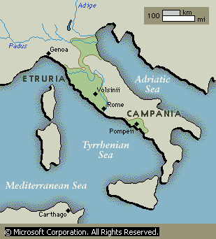

Slide 10
The Romans Establish a Republic
In 509 the last Etruscan monarch was overthrown as ruler of Rome and a new system of government was initiated.
Res Publica –that which belongs to the people or what we call a republic.

Slide 11
Roman Government
Republic
  form of government in which power rests with citizens who have the right to vote
    In Rome only free-born male adult citizens could vote.
    Patricians-landowning upper class (aristocrats)
    Plebeians- common farmers, artists and merchants
Goal was to prevent any individual from gaining too much power.
  What is the political term for this?
        Checks and Balances

Slide 12
Roman Government
The Senate
Most powerful governing body.
300 members (patrician class).
Served for life.
Jobs: Issued decrees, interpreted laws, and elected consuls to rule.

Slide 13
Consuls
Two consuls
Serve only 1-year terms.
The Consuls were also Patricians
Could “veto” acts of the other consul.
Veto means literally “I forbid”
Jobs: Supervised the business of government. Commanded the armies
By limiting their time in office the Romans had a way of “checking” their power.

Slide 14
Roman Government
In the event of a War a Dictator was chosen by the Senate
A Dictator is a person who has complete control over the government
They were granted power to rule for 6 months only.
After that time the Dictator had to give up power.
Cincinnatus was the greatest

Slide 15
Roman Government
The Plebeians made up a bulk of the population.
They had no political influence.
They argued for their right s and finally they were allowed to elect their own officials called Tribunes.
They could veto. any law that was not fair to the Plebeians
In 450 B.C. the 12 Tablets were created. These were tablets that had all of Rome’s laws carved on them

Slide 16
Family and Religion
Family
  center of religion, morals and education.
  Most important unit in Roman society.
  “Family” – included unmarried children, married sons and families, all dependent relatives and family slaves.
  Father was known as “paterfamililias”
Religion
  Adopted and identified with the gods of Greeks.
    Jupiter- king of the Gods.(Zeus)
    Juno- his wife protected marriage(Hera)
    Neptune- God of the sea.(Poseidon)
    Mars- the God of War(Ares)

Slide 17
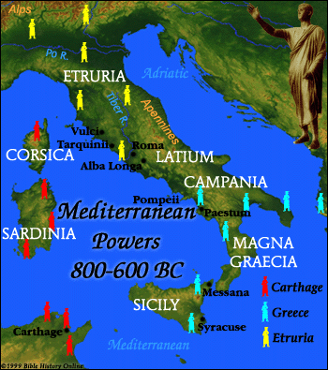
Questions:
What are the most notable geographic features of Italy?
How safe do you think Italy is from invasions?
How might Italy’s geographic position have contributed to its ability to expand into the Mediterranean?

Slide 18
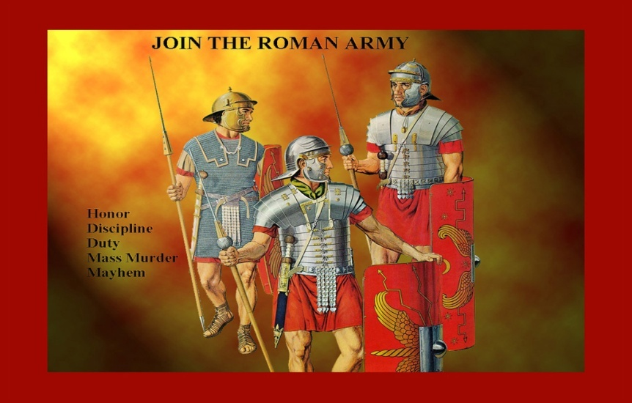
Roman Expansion and Wars
Info on army:
Efficient and well-disciplined.
Roman legion - 5,000 men
Loyal, courageous
Mixture of praise and punishment:
Unit that fled a battle faced decimation (1 in 10 put to death)

Slide 19
Conquering Lands and People
Profess loyalty to Rome.
Pay taxes and supply soldiers.
  Some chose citizenship.
  Soldiers occupied and posted in foreign lands.
  Built roads to link provinces.
  Locals began to adopt Roman language, customs and beliefs.

Slide 20
THE PUNIC WARS
ALL TWO OF THEM.
ACTUALLY THERE WERE THREE BUT THE THIRD WAS MORE LIKE A FOOD FIGHT

Slide 21
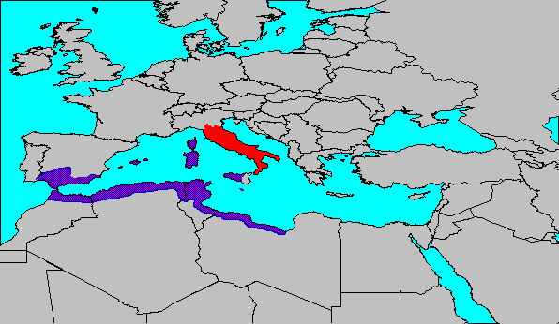
Carthage
Dispute over control of Sicily and trade routes in the western Mediterranean brought Rome into conflict with the powerful North African city-state of Carthage
Carthage had been founded as Phoenician colony 500 years earlier
Result was the three Punic Wars
264-146 BC

Slide 22
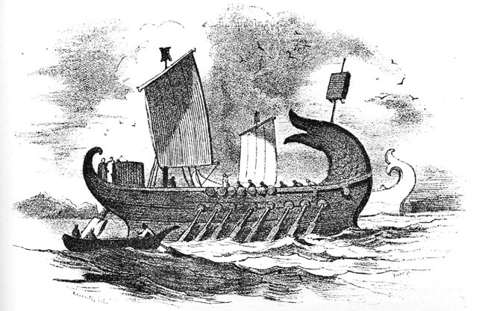
FIRST PUNIC WAR
Primarily a naval war
  Tactics: maneuver ship to ram and sink enemy
    Carthage: very good, experienced naval power
    Rome: small navy, little experience
      Defeated repeatedly by Carthaginian navy

Slide 23
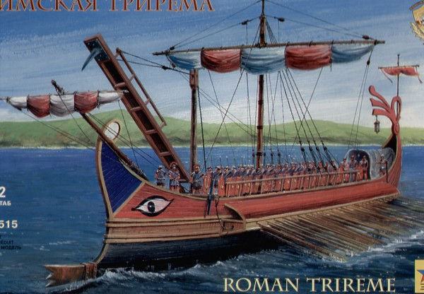
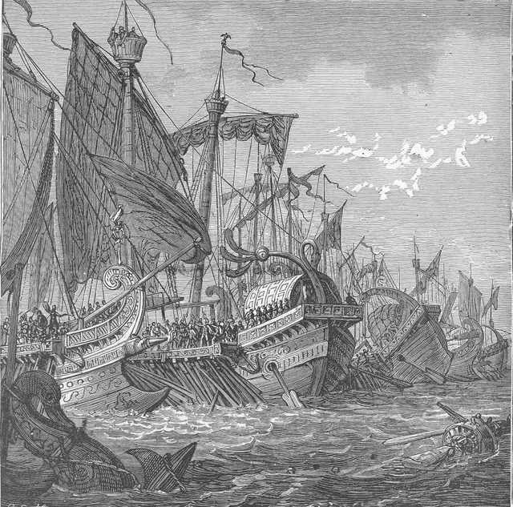
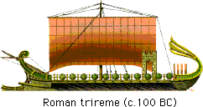
ROME WINS THE FIRST ONE
Rome would not surrender
  Finally turned tables on Carthage by changing rules of naval warfare
    Equipped ships with huge hooks and
    Stationed soldiers on ships
    Would hook enemy ship, pull nearby, board it with soldiers
  Converted naval warfare into mini-land battles
    Something Rome was very good at
    Won First Punic War as a result

Slide 24
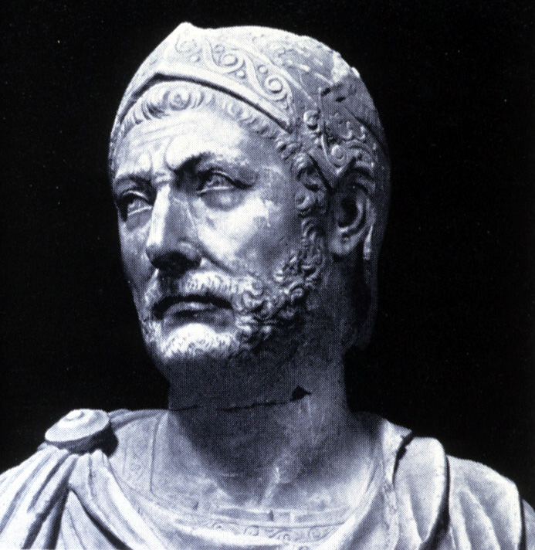
The Best That Ever Did It

Slide 25
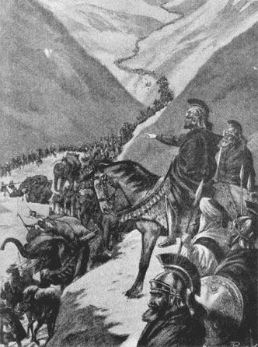
SECOND PUNIC WAR
"Hannibal ad portas" (“Hannibal is at the Gates!”)
Carthagian general Hannibal surprises Romans,
leads army from Spain, through southern France and the Alps,
invades Italy from the north
Defeats Roman armies sent to stop him several times but hesitates to attack Rome itself
Too well fortified
Settles instead on war of attrition in hope of destroying Roman economic base

Slide 26
Hannibal Barca (247-183 BC) *Carthaginian general*Brilliant strategist *Developed tactics of outflanking and surrounding the enemy with the combined forces of infantry and cavalry
As a boy of 9, begged his father, Hamilcar Barca, to take him on the campaign in Spain.
Hamilcar, made him solemnly swear eternal hatred of Rome.
Livy’s portrait of Hannibal's physique and character at this time:
  “…to the old soldiers he seemed a Hamilcar reborn, as he possessed the lively expression and penetrating eyes of his father; the younger men were won over by his bravery, endurance, simplicity of life, and willingness to share all hardships with his troops.”

Slide 27
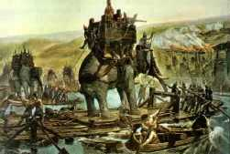
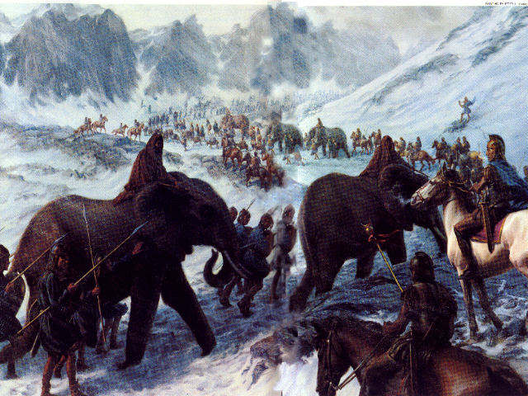
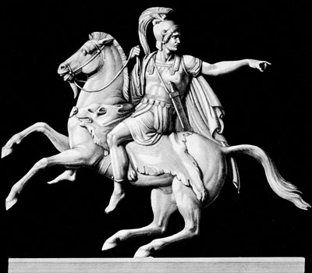
Hannibal-the-Conqueror
"I swear that so soon as age will permit . . . I will use fire and steel to arrest the destiny of Rome." ~~Childhood Hannibal Quote
Born about 247 - Died 183BC

Slide 28
Spain
Hannibal, commander in chief @ 26
Consolidated Carthaginian power in Spain
219 he besieged Saguntum, a city south of the Iberus River (Ebro) – and ally of Rome
Iberus River line-of-demarcation between Roman and Carthaginian spheres of influence
Blockade of Saguntum
8-month siege
Declaration of war

Slide 29
Alps
Hannibal conceived of an invasion of Italy from the north
Wanted them crushed on own turf—counted on disaffected allies
Crossed the Iberus-bloody battles with Spanish tribes
Marched with about 40,000 men across the Pyrenees
In Gaul, quick progress to Rhone River
Transported army & war elephants across the river

Slide 30
15 days marched through rugged mountain passes
Enormous army
Diverse origin and language
    40,000 Warriors from many different nations
    38 war elephants
    enemy attacks
    landslides
    early autumn snow
Heroic feat
Captured the imagination of historians and poets alike

Slide 32
When Hannibal reached the Po Valley army was reduced to half its former size most of his war elephants were lost
Met the army of Publius Scipio at the Ticinus River
Hannibal's Numidian cavalry won decisive victory
Scipio seriously wounded, withdrew to the Trebia River
Consular army of Titus Sèmpronius Longus, recalled by Senate from Sicily to join
Tactics of ambush & outflanking vs. enemy
Hannibal defeated combined armies of Romans
Caused loss of ~20,000 Roman soldiers

Slide 33
Italy
Spent winter in Po Valley
Gained many recruits among the Gauls & others
Crossed Apennines in spring of 217.
Ravaged Etruria
Provoked pursuit of new consul Gaius Flaminius
Rushed down from ambush on opposing hills
Hannibal's troops annihilated almost entire army
Intercepted & destroyed cavalry

Slide 34
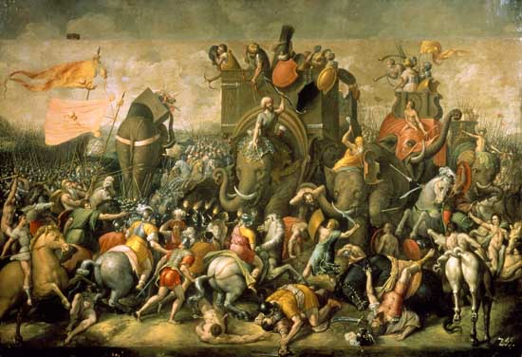

Slide 35
Hannibal marched to Picenum
Granted troops rest in hopes that Italian allies would defect
Continued to ravage Apulia & Campania
Following year, new consuls, new aggressive war policy
Hannibal beat the Romans in the worst defeat they had ever suffered: Cannae
Strategy of outflanking the enemy again brought victory to the Carthaginians over superior numbers

Slide 36
Capua & many other cities in S. Italy revolted vs Rome
Weakened forces prevented taking full advantage
Changed from offensive to a defensive policy
Carthage gov’t refused to send adequate reinforcements
Captured Tarentum & Bruttium…but
Gradually lost ground vs superior Roman numbers

Slide 37
Negotiations with Philip V of Macedon
Small band Numidian cavalry sent from Carthage--weak
211, Hannibal marched on Rome
Pitched camp Anio River 3-miles from Rome
Withdrew again hope brother Hasdrubal fresh troops brother's bloody head thrown at his feet testimony to destruction of Hasdrubal's army Battle of the Metaurus
Hannibal now concentrated forces in Bruttium
Held ground 4 more years
Recalled in 203 to defend Carthage against the victorious army of Publius Cornelius Scipio the Elder (Scipio Africanus Major).

Slide 38
Africa
Back in Carthage after 16 years of victorious warfare
Hannibal defeated by Scipio Africanus
Battle of Zama
Ironically, Hannibal victim of his own strategy:
  Scipio outflanked & surrounded Carthaginians
  Aid of King Masinissa's Numidian cavalry
Hannibal escaped with a few horsemen
Rushed to Carthage
Counseled peace
Treaty in 201

Slide 39
ROME WINS
Unable to defeat Hannibal in Italy, a Roman army sailed across the Mediterranean, landed in North Africa, and headed for Carthage
  Led by patrician general Scipio Aemilius Africanus
  Hannibal forced to leave Italy to protect Carthage
    Defeated at the Battle of Zama, fought outside the walls of Carthage
Hannibal

