Slide 1
The rise of Christianity

Slide 2
In The Beginning
Romans were tolerant of the people they conquered religions.
Most people were polytheistic so adding the Roman Gods to their group was not a problem
By 63 BC Romans had conquered Judea
The Jewish were allowed to worship their one God

Slide 3
Divisions Arise in Judea
There was drama within Judaism within Judea
3 different groups were growing
The Sadducees- wanted to go along with Roman rule
Essenes- waited for the Messiah- An anointed King sent by God
Zealots- wanted to violently overthrow the Romans

Slide 4
The Rebellion is Defeated
In A.D. 66 the Zealots rebel and are crushed 4 years later.
Because of the rebellions many Jewish people either died, were sold into slavery or just left Judea

Slide 5
Jesus Christ Superstar
Born in 4 B.C. in Bethlehem son of the virgin Mary s
Grew up in Galilee , which had a lot of Zealots
worshipped God and followed Jewish law
at age 30 began preaching to villagers, used parables -short stories with simple moral lessons to communicate his ideas
He told everyone he was the son of God
Recruited 12 of his disciples (a close follower) to help him spread his ideas, called apostles -( A person sent forth), in Jerusalem
Some Jews in Jerusalem welcomed Jesus, many of the priests felt he threatened their leadership
Roman authorities felt Jesus would lead the Jews in a revolt against their rule

Slide 6
Condemned to Death
Jesus was betrayed by one of his disciples
He was arrested by the Romans, tried and then sentenced to death by Crucifixion
The bible says his disciples saw him and spoke with him
He told them to spread his teachings to all people and then he ascended up to heaven

Slide 7
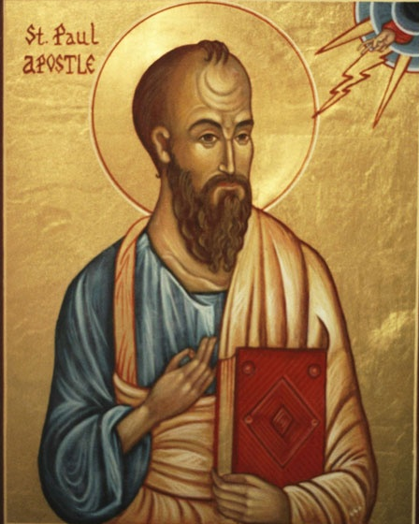
The Spreading of Christianity
Paul- a Jew from Asia-Minor did the most for the spreading of Christianity
He had never met Jesus
Used to persecute Christians
Had a vision of Jesus speaking to him and immediately changed

Slide 8
The Spreading of Christianity
Traveled all over the Mediterranean spreading the Gospel
Set up churches from Mesopotamia to Rome
His teachings and letters became part of the New Testament

Slide 9
Oppression
Rome didn’t have tolerance for Christianity
They felt it was a threat, It grew to fast
Christians didn’t worship the emperor
Nero blamed them for Burning Rome
They were slaughtered in the Coliseum
Paul became a Martyr- a person who dies for their beliefs

Slide 10
Many Felt Christianity
Jesus appealed to everyone
The roads of the empire made it easy to get around the entire empire
The early documents were written in Latin or Greek which many people spoke

Slide 11
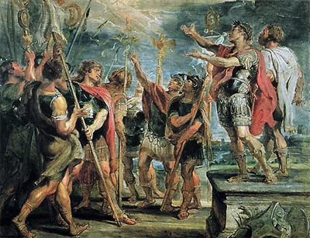
Acceptance, Praise the Lord
Emperor Constantine issued the Edict of Milan in A.D. 313.
The Edict granted freedom of worship to all citizens of the Roman empire
By the end of the century, Emperor Theodosius made Christianity the official religion of the Roman empire

Slide 12
Heresy- beliefs that go against the church’s teaching

